Slide 1
Supervisor Meeting
G3T2
30-October 2014
Yuan Yuxuan
Max Chua
Aayush GARG
Eva Tan
Wu Di

Slide 2
Agenda
Progress for past two week
  Iteration 4
    Automatic Group Detection
    Web Service & JSON
    Administrator file upload
  Iteration 5 ( in progress)
    Group Aware Location Report
    Web Service & JSON for groups
    Update Bootstrap
    Make changes from Heuristics
Goals
  UAT
  Implementation
Roles
Metric
Notes:
We have a better time management, we learn from the pervious iterations and make some improvement

Slide 3
Progress thus far
Iteration 4: (18/10/2014 – 25/10/2014)
  Automatic Group Detection
  Web Service & JSON
  Administrator file upload
  Continue Testing for all functionalities
Iteration 5: (26/10/2014 – 31/10/2014
  Group Aware Location Report
  Web Service & JSON
  Make change for Bootstrap
  Continue Testing for all functionalities
Progress for past weeks
Deviation from plan
Goals next iteration
Problem
Roles
Metric

Slide 4
Goals next iteration
Functionality: Coach: Yuxuan & Max
  Group Aware Location Report
    Eva and Yuxuan
  Web service and JSON
    Max and Aayush
  Bootstrap change according to the requirement
Better project management
  More even distribution of coding hours
Progress for past weeks
Deviation from plan
Goals next iteration
Problem
Roles
Metric

Slide 5
Goals next iteration
Functionality:
  Improve functionalities and UI from UAT
  Generate more test cases to keep testing
Better project management
  More even distribution of coding hours
Progress for past weeks
Deviation from plan
Goals next iteration
Problem
Roles
Metric

Slide 6
Roles
Iteration 4
  Project Manager: Wu Di
  Coach: Max and Yuan Yuxuan
  JSON & Web Service: Max & Eva
  Administrative Updating Data: Max & Eva
  Automatic Group Detection: Yuxuan & Aayush
Iteration 5
  Project Manager: Wu Di
  Coach: Max and Yuan Yuxuan
  JSON for Groups: Max & Aayush
  Group Aware Location Report: Yuxuan & Eva
  Update Bootstrap: Max & Aayush
  Changes from Heuristics: Max & Aayush
Progress for past weeks
Deviation from plan
Goals next iteration
Problem
Roles
Metric

Slide 7
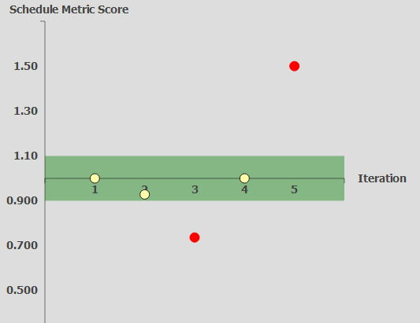
Metric – Schedule Metric
Progress for past weeks
Deviation from plan
Goals next iteration
Problem
Roles
Metric

Slide 8
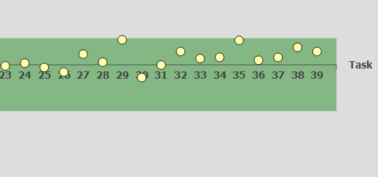
Metric – Pair Programming Metric
Progress for past weeks
Deviation from plan
Goals next iteration
Problem
Roles
Metric

Slide 9
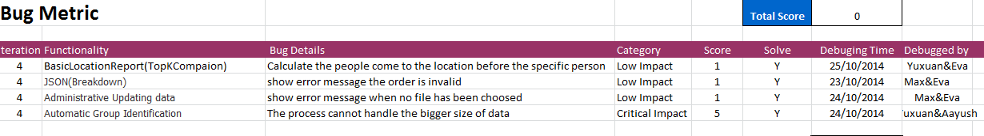
Metric – Bug Metric
Progress for past weeks
Deviation from plan
Goals next iteration
Problem
Roles
Metric

